Slide 1
i1:{p,q,r}->{T,F} i1(p) = T, i1(q) = T, i1(r) = T
A = T → (T ^ T) v T ^ ¬ T
A = T → T v T ^ F
A = T →T v F
A = T→T
A = T

Slide 2
i2:{p,q,r}->{T,F} i2(p) = T, i2(q) = T, i2(r) = F
A = T → (T ^ F) v T ^ ¬ T
A = T → F v T ^ F
A = T → F v F
A = T → F
A = F

Slide 3
i3:{p,q,r}->{T,F} i3(p) = T, i3(q) = F, i3(r) = T
A = T → (F ^ T) v F ^ ¬ T
A = T → F v F ^ F
A = T → F v F
A = T → F
A = F

Slide 4
i4:{p,q,r}->{T,F} i4(p) = T, i4(q) = F, i4(r) = F
A = T → (F ^ F) v F ^ ¬ T
A = T → F v F ^ F
A = T → F v F
A = T → F
A = F

Slide 5
i5:{p,q,r}->{T,F} i5(p) = F, i5(q) = T, i5(r) = T
A = F → (T ^ T) v T ^ ¬ F
A = F → T v T ^ T
A = F → T v T
A = F → T
A = T

Slide 6
i6:{p,q,r}->{T,F} i6(p) = F, i6(q) = T, i6(r) = F
A = F → (T ^ F) v T ^ ¬ F
A = F → F v T ^ T
A = F → F v T
A = F → T
A = T

Slide 7
i7:{p,q,r}->{T,F} i7(p) = F, i7(q) = F, i7(r) = T
A = F → (F ^ T) v F ^ ¬ F
A = F → F v F ^ T
A = F → F v F
A = F → F
A = T

Slide 8
i8:{p,q,r}->{T,F} i8(p) = F, i8(q) = F, i8(r) = F
A = F → (F ^ F) v F ^ ¬ F
A = F → F v F ^ T
A = F → F v F
A = F → F
A = T

Slide 9
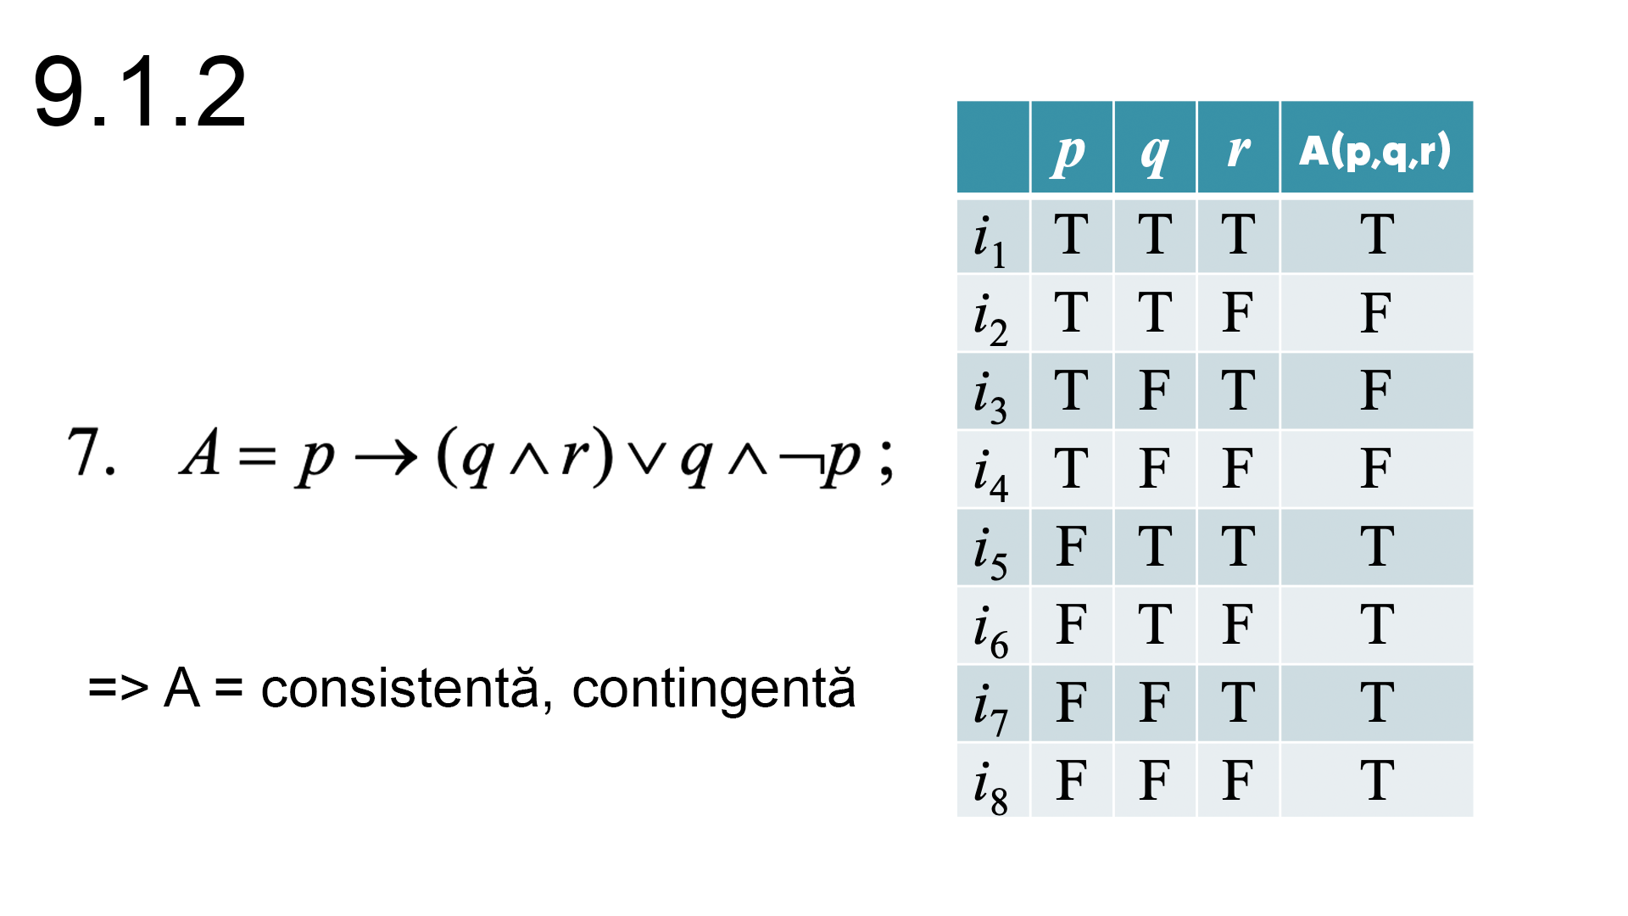
Antimodele: i2, i3, i4
Modele: i1, i5, i6, i7, i8

